Slide 1


Music Source Separation in the Waveform Domain
Article from 2020 written by Défossez A., Usunier N., Bottou L. and Bach F.
Arthur Viens, 2023 January 05

Slide 2

summary
1 - introduction
2 - related works
3 - architectures
4 - hyperparameters
5 - results
6 - Usage

Slide 3
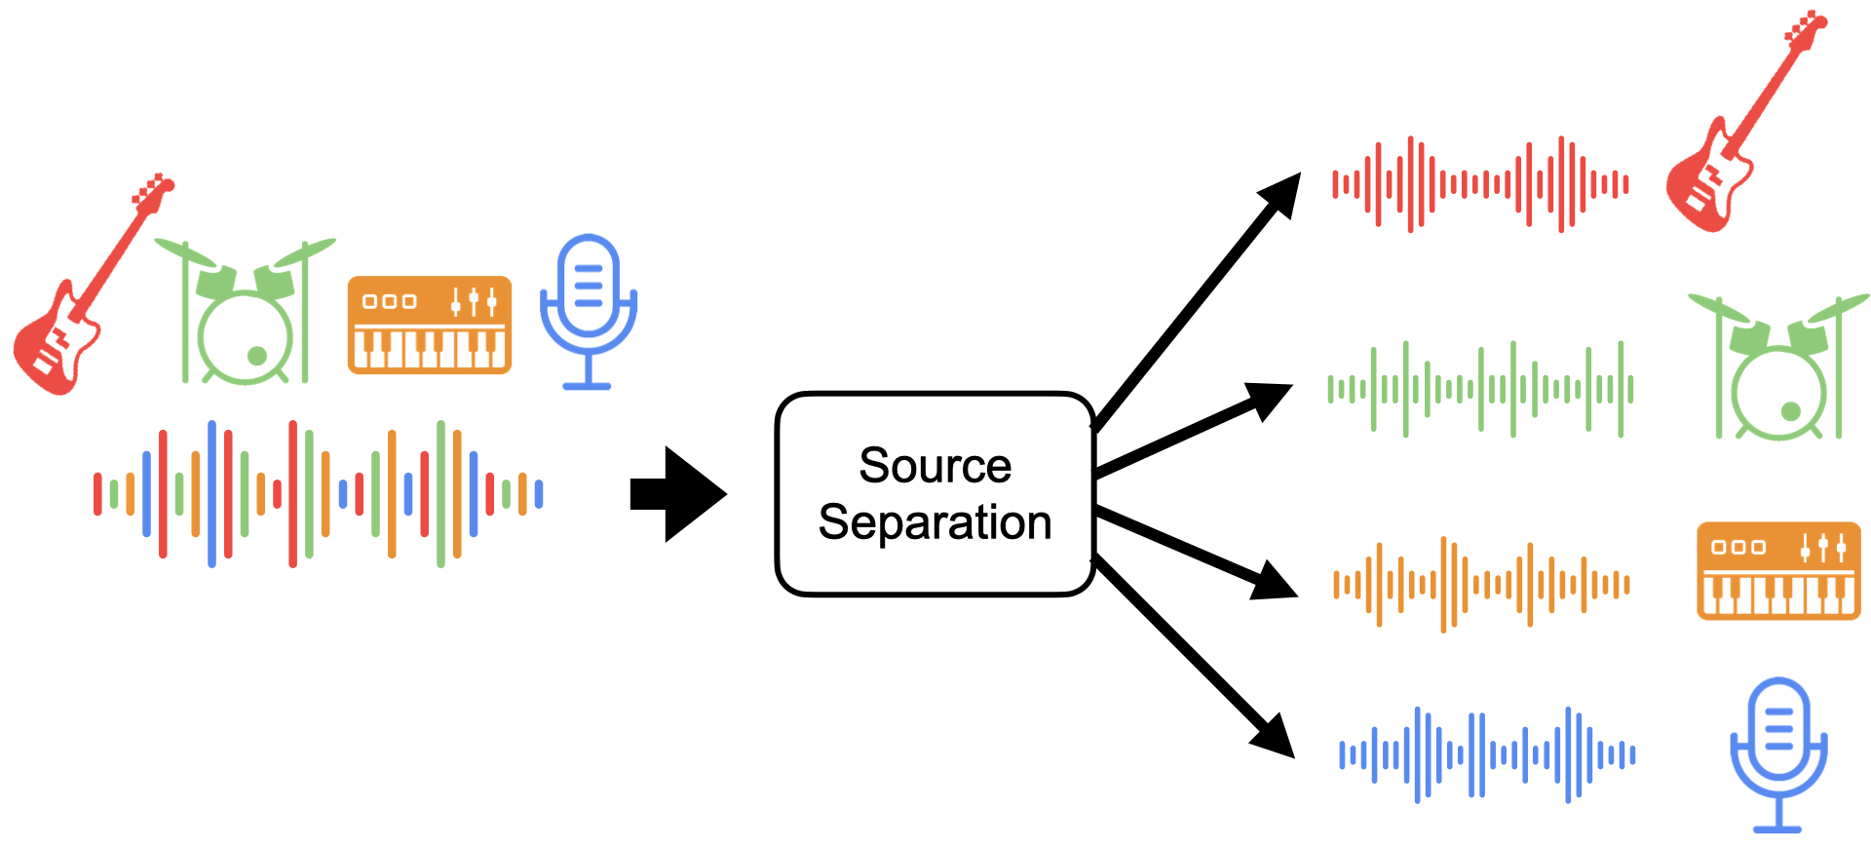
1 - Introduction
Context of the paper : Tackle music source separation with Deep Learning Methods
Scientifically related to Non-Intrusive Load Monitoring performed at Smart-Impulse

Slide 4
Paper contributions to music source separation
Adaptation of a speech source separation Deep Learning model Conv-TasNet¹ to music source separation in the time domain.
Development of a new Deep Learning architecture Demucs for music source separation in the time domain. It reaches state-of-the-art performance in SDR metric.
Detailed analysis of baseline models, Conv-TasNet and Demucs, both in terms of performance metrics (SDR) and human perception (Mean Opinion Score) when calculation is possible.

Slide 5
Related works in music source separation
Blind (unsupervised) source Separation
Non-negative Matrix Factorization
Idependent component Analysis
Deep Learning methods
Two broad types of methods : Spectrogram domain methods or Waveform domain methods
Spectrogram methods usually produce masks on magnitude spectrums for each source
Before Demucs, Waveform methods performances were far below spectrogram ones
Mainly CNNs and RNNs are used, and even meta-learning

Slide 6
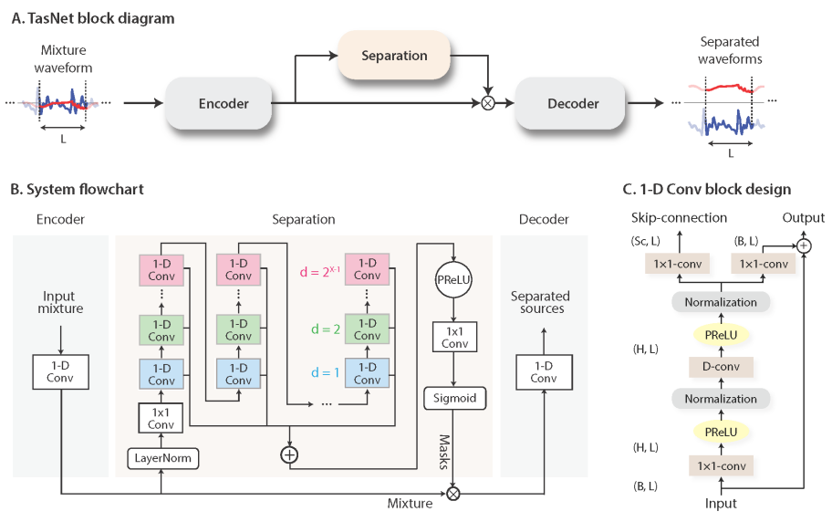
Network architecture : Conv-Tasnet
Encoder – Decoder
Separation module (Residual Blocks)
Masking method
1-D Conv blocks (1x1 + dilated Convs)
Skip Connections
Normalization & PReLU

Slide 7
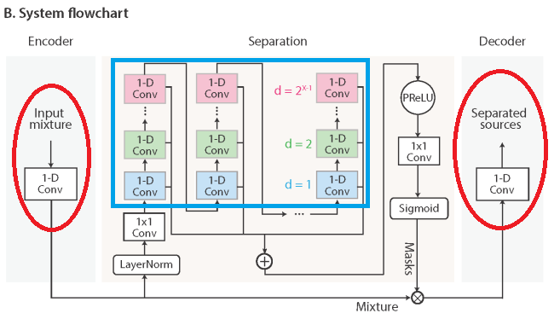
Network architecture : modified Conv-Tasnet
Encoder/Decoder Modification : Increased kernel size (16 → 20) and stride (8 → 10). Number of channels (128 → 256)
Separation module : 4 blocks instead of 3, d = 1 to 10 instead of 1 to 8

Slide 8
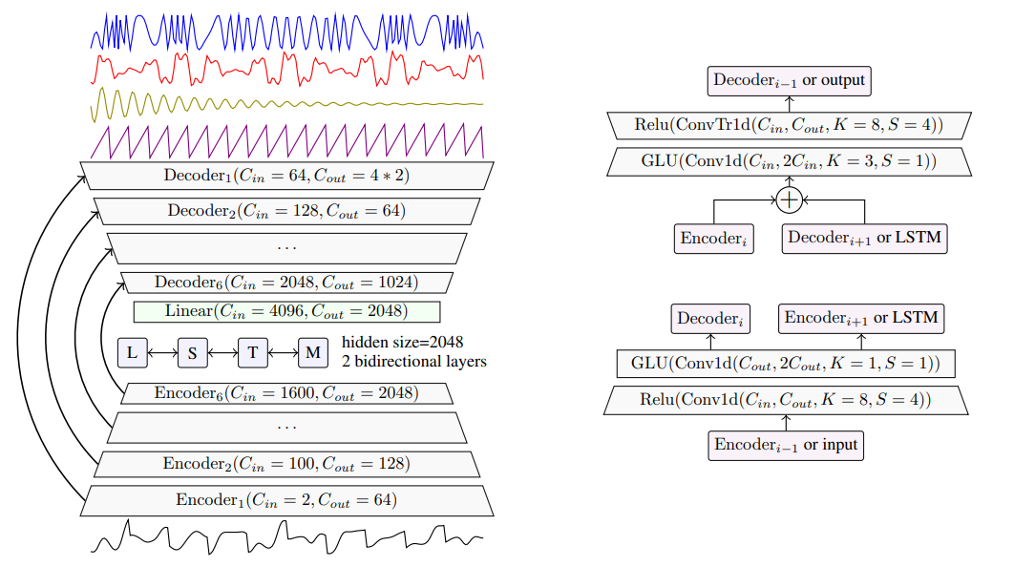
Network architecture : demucs
Convolutional Encoder – Decoder
Bi-LSTM
U-Net like skip-connections
Gated Linear Units (GLU)

Slide 9
Demucs architecture design choices
Convolutional Encoder – Decoder : Time-domain high-dimensional representation learning of the audio signal
Gated Linear Units : Performing masks on learnt representation (with the hope for the DNN to learn audio masking phenomenons)
1x1 Convolutions : increase depth and expressivity of the model at low computing cost
Bi-LSTM : Crucial part of the model, working on encoded representation to model time dependencies along the waveform
U-Net like skip connections : Multi-scale representations of the input, due to successive convolutional layers + directly transfers the phase of the input signal to the output + makes training faster

Slide 10
Demucs hyperparameters and training
Training
360 epochs over MusDB dataset Each song is cut in 11s extracts with a stride of 1s, and a random shift of 0 to 1s is applied
Data Augmentation : Shuffling sources in a batch for a new mixture, swapping mono/stereo channels, random scaling between 0.25 and 1.25, pitch scaling, tempo shift
8 V100 GPUs, 16GB RAM
Hyperparameter | Value
Batch size | 64
Optimizer | Adam
Learning-rate | 3e-4
Initial modified Kaiming rescaling | α = 0.1
Training Loss | L1 or L2 Finally used L1
Normalization | No (in v2)

Slide 11
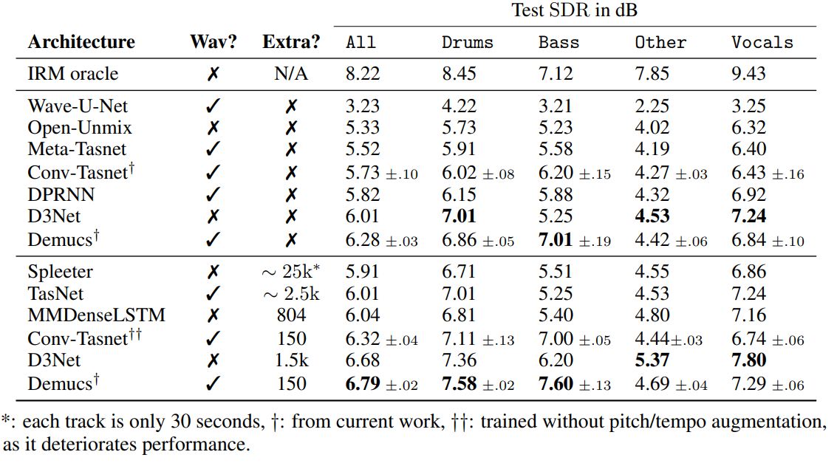
Experimental results
0.8 seconds to unmix 1 min of audio on a V100 GPU
0.3 dB SDR better than SOA without extra data
SOA even with extra data
Lowest size of extra data used (room to increase performance)

Slide 12



usage of demucs open-sourced code

